Slide 1
VR the saviours
VAPS

Slide 2
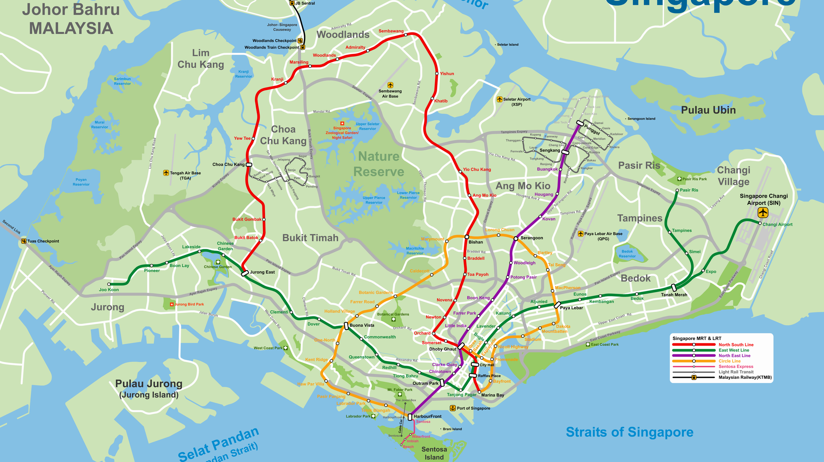
Smart nation
With the emergence of Singapore as a smart nation
Our country have to be prepared to take on any disastrous situation
We aim to successfully simulate such situation in VR so that we can prepare the country.
This Photo by Unknown Author is licensed under CC BY-SA

Slide 3
How we did it
Used Unity3D to build scenes and assets.
Used GoogleVR to export from Unity3D to VR.
Used C# to modify buttons and select

Slide 4
Use Cases
To teach the general population how to respond in disaster situation.
Can be used in the following places
Schools
Offices
Apartment residences

Slide 5
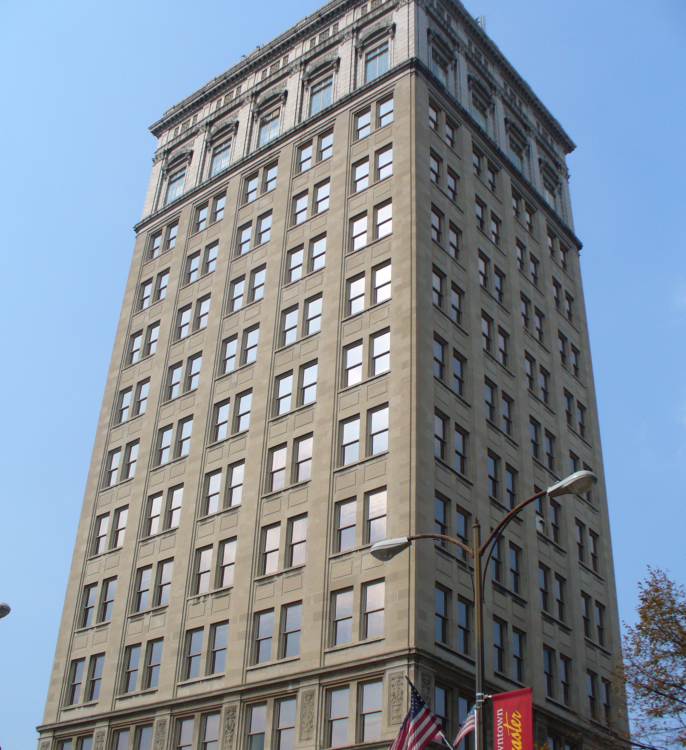
Implementation in real life
This Photo by Unknown Author is licensed under CC BY-SA

Slide 6
Improving the hack
Add
Add audio support
Make
Make the FPS experience better
Make
Make an asset library which allows us to build simulations quickly
Make
Make a C# library which will suit our situational needs

Slide 7
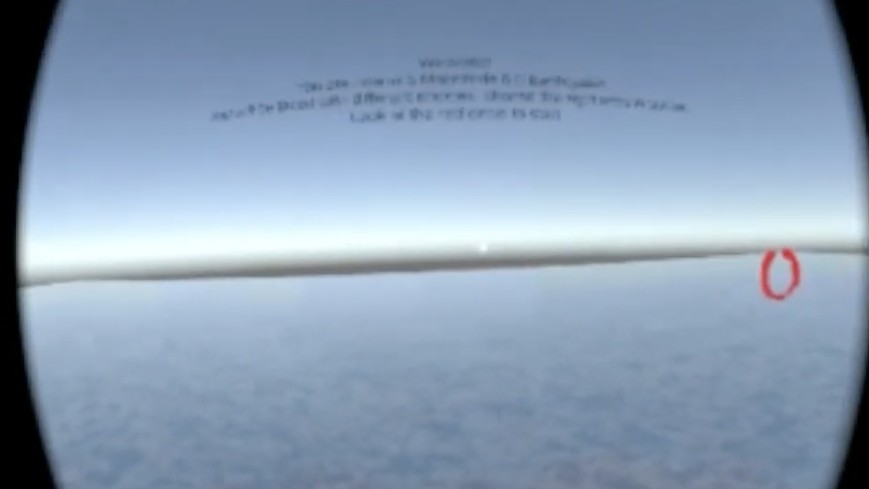
Demo

